Slide 1

Technologies enabling cloud computing

Slide 2
Cloud computing technologies
Virtualization
Load balancing
Programming models
Cloud storage

Slide 3
Intended learning outcomes
After completing this topic, you will be able to:
Discuss system, network and storage virtualization and outline their role in enabling the cloud computing system model
Discuss issuea of load balancing
Analyze various cloud programming models and apply them to solve problems on the cloud
Illustrate the fundamental concepts of cloud storage and demonstrate their use in storage systems

Slide 4
Cloud computing technologies
Virtualization
Load balancing
Cloud storage
Programming models

Slide 5
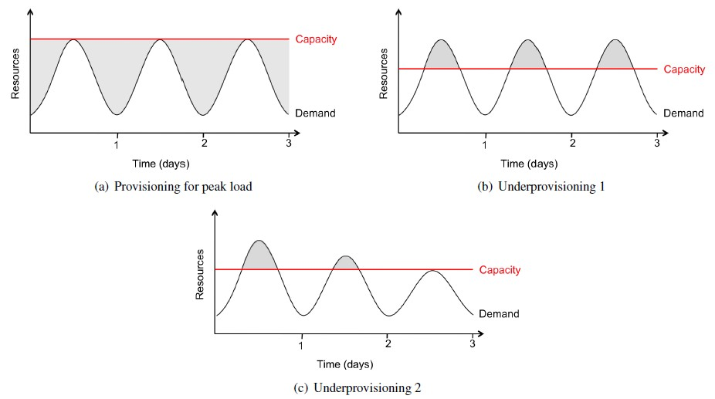
Resource Provisioning problems - Company's/Customer's View
Resource Wastage
Unserved Requests
Loss of Customers
Big Headache

Slide 6
Resource Provisioning problems - Company's/Customer's View
Resource Wastage
Unserved Requests
Loss of Customers
Big Headache

Slide 7
Resource Provisioning problems - Provider's/Customer's View
Resource Wastage
Unserved Requests
Loss of Customers
Big Headache

Slide 8
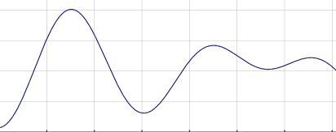
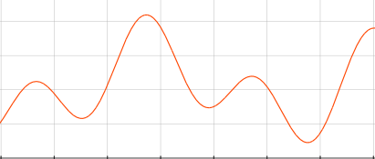
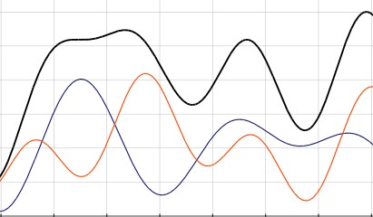
Resource Provisioning – Data Center/Cloud Provider's View
2000 2050
0
0
Company ­ BLUE
Company ­ RED
Consider the Data Center or a Cloud provider that needs to serve 2 customers with the following needs:
Peak demand of the “Company BLUE” customer is 2000 machines
Peak demand of the “Company RED” customer is 2050 machines
3000
0
Cloud Provider

Slide 9
Resource Provisioning – Data Center/Cloud Provider's View
2000 2050
0
0
Company ­ BLUE
Company ­ RED
3000
For the Data Center, or the Cloud provider, to serve these 2 customers, there is a need to provide 4050 machines
0
Cloud Provider

Slide 10
Resource Provisioning – DataCenter/Cloud Provider's View
2000 2050
0
0
Company ­ BLUE
Company ­ RED
3000
However, the peak demands of the two customers is not at the same time
Some machines can be used to serve both customers at different times
0
Cloud Provider

Slide 11
Resource Provisioning – Data Center/Cloud Provider's View
2000 2050
0
0
Company ­ BLUE
Company ­ RED
3000
The black line shows the number of machines needed to meet the demand from the both customers at any given time
Maximum 3000 machines are needed to meet the demand
0
Cloud Provider

Slide 12
Resource Provisioning – DataCenter/Cloud Provider's View
2000 2050
0
0
Company ­ BLUE
Company ­ RED
3000
- Charge for 4050 machines, work with 3000
- Good business
- Computing as a service or utility
0
Cloud Provider

Slide 13
Cloud Computing requirements
Scaling infrastructure on demand within minutes or even seconds, instead of days or weeks, thereby avoiding under­utilization (idle servers) and over­utilization
Accessing resources and services needed to perform functions with dynamically changing needs

Slide 14
Virtualization definition (1)
Virtualization is the creation of a virtual (rather than physical) version of something, such as
an operating system
a server
a storage device
or network resources.
It hides the physical characteristics of a resource from users, instead showing another abstract resource.

Slide 15
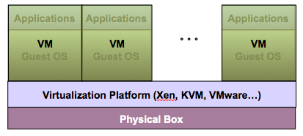
Virtualization Architecture
Multiple virtual machines (VMs) can run on a single physical system
Guest OS assumes complete control of the underlying hardware
Virtualization architecture provides this illusion through virtualization platform

Slide 16
Virtual machine
A Virtual machine (VM) is a software implementation of a machine (i.e. a computer) that executes programs like a real machine
VM is an isolated runtime environment (guest OS and applications)

Slide 17
Host vs guest
Host (Target)
The primary environment - the machine on which the virtual machine is created
Guest (Source)
The virtualized environment

Slide 18
Virtualization platform
Other names
Hypervisor
Virtual machine manager (VMM)
Virtual machine monitor (VMM)
Virtualization manager
A software layer which provides virtualization:
Allows multiple Guest OS to run simultaneously on a single physical host
Provides hardware abstraction to the running Guest OSs and efficiently multiplexes underlying hardware resources.

Slide 19
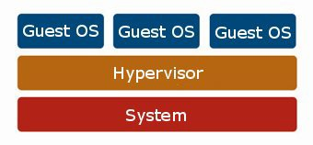
Virtualization – resource sharing and isolation
Each guest OS appears to have the host's processor, memory, and other resources all to itself
However, the hypervisor is actually controlling the host processor and resources
Allocates what is needed to each operating system in turn
Makes sure that the guest operating systems cannot disrupt each other
Hardware

Slide 20
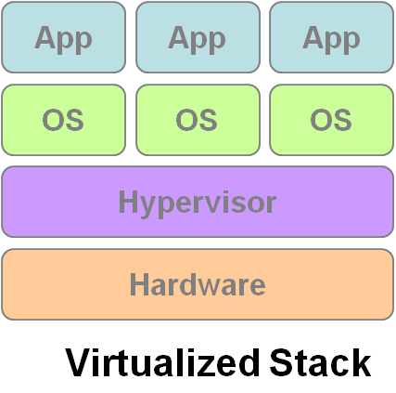
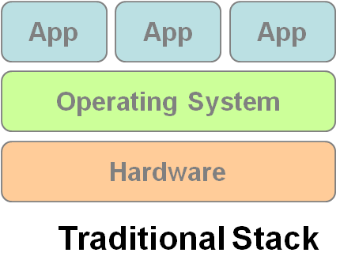
Virtualization
VM1
VM2
VM3

Slide 21
Benefits of Virtualization
Sharing of resources helps cost reduction
Isolation: Virtual machines are isolated from each other as if they are physically separated
Encapsulation: Virtual machines encapsulate a complete computing environment
Hardware independence: Virtual machines run independently of underlying hardware
Portability: Virtual machines can be migrated between different hosts.

Slide 22
Virtualization in Cloud Computing
Cloud computing takes virtualization one step further:
You don’t need to own the hardware
Resources are rented as needed from a cloud
Various providers allow creating virtual servers:
Choose the OS and software each instance will have
The chosen OS will run on a large server farm
Can instantiate more virtual servers or shut down existing ones within minutes
You get billed only for what you used

Slide 23
Importance of Virtualization in Cloud Computing
Cloud can exist without Virtualization, although it will be difficult and inefficient
Cloud makes notion of “Pay for what you use”, “infinite availability- use as much you want”
These notions are practical only if we have
lots of flexibility
efficiency in the back-end
This efficiency is readily available in Virtualized Environments and Machines
Virtualization is the foundation which supports cloud computing

Slide 24
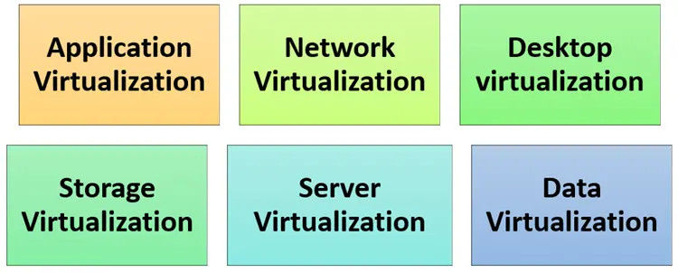
Types of Virtualizations

Slide 25
Types of Virtualizations

Slide 26
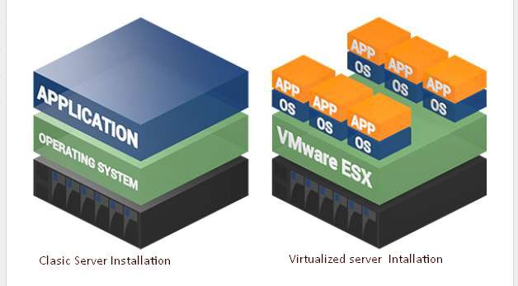
Server Virtualization
When the hypervisor is directly installed on the server system

Slide 27
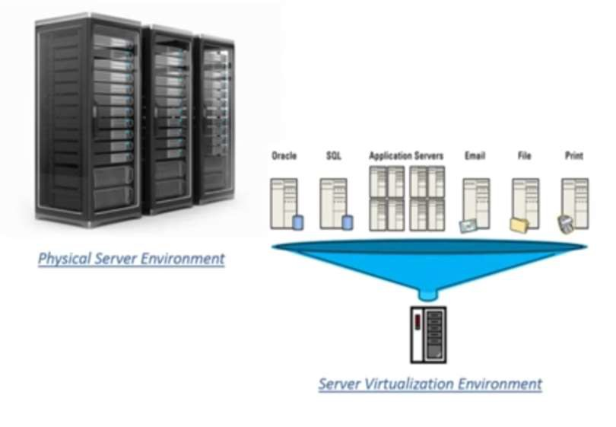
Server Virtualization
A single physical server can be divided into multiple servers
on the demand basis
for balancing the load

Slide 28
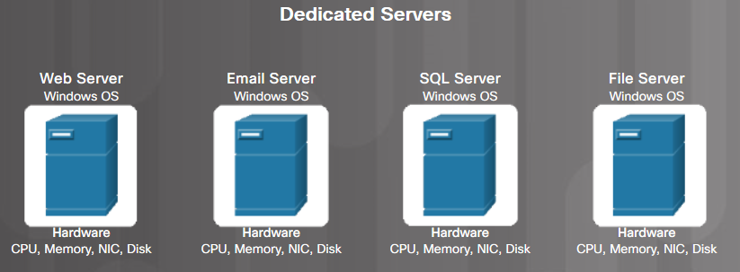
Traditional Server Deployment
Traditionally, organizations delivered applications and services using powerful dedicated servers.
These dedicated servers are equipped with large amounts of RAM, powerful CPUs, and multiple large storage devices.
Disadvantages include: wasted resources, single-point of failure, and server sprawl.

Slide 29
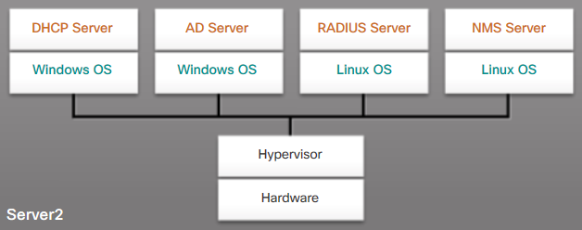
Server Virtualization
Server virtualization takes advantage of idle resources to reduce the number of servers required

Slide 30
Advantages of Server Virtualization
Better use of resources
Less space required
Less energy consumed
Reduced cost
Faster server provisioning
Maximize server uptime
Improved disaster recovery
Support for legacy systems

Slide 31
Hypervisor Types
Type 1 – Bare metal
Hypervisors run directly on the host's hardware as a hardware control and guest operating system monitor
Type 2 – Hosted
Hypervisors are software applications running within a conventional operating system

Slide 32
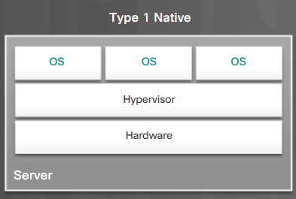
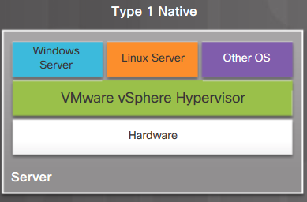
Type 1 Hypervisors
Type 1/bare metal/native
Typically used with server virtualization
For example, they are used in data centers and cloud computing
Run directly on the hardware of a host, and manage the allocation of system resources to VMs

Slide 33
Type 1 Hypervisors
Type 1/bare metal/native
Typically used with server virtualization
For example, they are used in data centers and cloud computing
Run directly on the hardware of a host, and manage the allocation of system resources to VMs

Slide 34
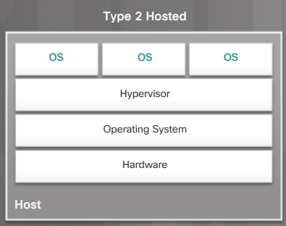
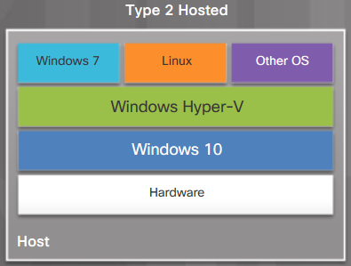
Type 2 Hypervisors
Type 2/hosted
Commonly used with client-side virtualization.
Type 2 hypervisors work with the host computer to create and use multiple VMs

Slide 35
Type 2 Hypervisors
Type 2/hosted
Commonly used with client-side virtualization.
Type 2 hypervisors work with the host computer to create and use multiple VMs

Slide 36
Server virtualization types
Hardware level virtualization
OS level virtualization

Slide 37
Hardware level virtualization

Slide 38
Hardware level virtualization - definition
The creation of a virtual machine that acts like a real computer with an operating system

Slide 39
Hardware level virtualization - hypervisor
The hypervisor is directly installed on the hardware system
The main job of hypervisor is to control and monitor
Processor
Memory
Other hardware resources

Slide 40
Hardware level virtualization - example
After virtualization of hardware system we can install different operating system on it and run different applications on those OS
For example, a computer that is running Arch Linux OS may host a virtual machine that looks like a computer with the Microsoft Windows OS; Windows-based software can be run on the virtual machine

Slide 41
Types of hardware level virtualization
Full-Virtualization
Almost complete simulation of the actual hardware to allow software environments, including a guest operating system and its apps, to run unmodified
Hypervisor simulates enough hardware to allow an unmodified guest OS
Para-Virtualization
Hypervisor does not necessarily simulate hardware, but instead offers a special API that can only be used by the modified guest OS
The guest apps are executed in their own isolated domains, as if they are running on a separate system, but a hardware environment is not simulated
Guest programs need to be specifically modified to run in this environment

Slide 42
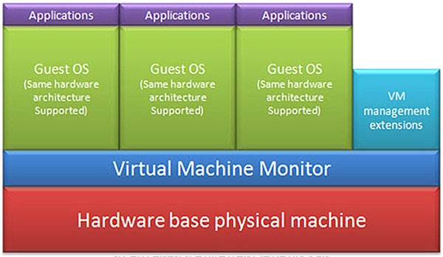
Full-Virtualization
Pros | Need not to modify guest OS
Cons | Significant performance hit

Slide 43
Full-Virtualization
Advantages:
No modification to the Guest operating system is required.
Limitations:
Complex
Slower due to emulation
Installation of the new device driver is difficult

Slide 44
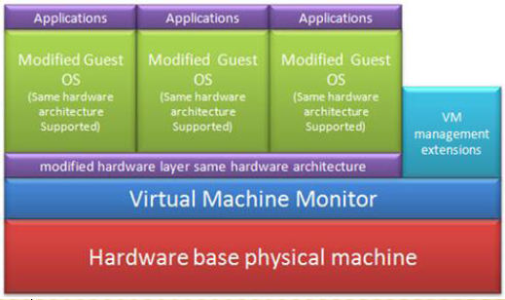
Para-Virtualization
Pros | Light weight and high performance
Cons | Require modification of guest OS

Slide 45
Para-Virtualization
Advantages:
Easier
Enhanced Performance
No emulation overhead
Limitations:
Requires modification to a guest operating system

Slide 46
Hardware-Assisted Virtualization
Requires hardware support

Slide 47
Hardware-Assisted Virtualization
Advantages:
No modification to a guest operating system is required
Very little hypervisor overhead
Limitations:
Hardware support required

Slide 48
OS level virtualization
A physical server is virtualized at the operating system level
Enables multiple isolated and secure virtualized servers to run on a single physical server

Slide 49
OS level virtualization - definition
OS level virtualization is an operating system (OS) paradigm in which the kernel allows the existence of multiple isolated user space instances, called containers (or zones, virtual private servers, partitions, virtual environments, virtual kernels, jails, …, )
Such instances may look like real computers from the point of view of programs running in them

Slide 50
OS level virtualization - isolation
A computer program running on an ordinary operating system can see all resources (connected devices, files and folders, network shares, CPU power, quantifiable hardware capabilities) of that computer
However, with operating-system-virtualization, it is possible to run programs within containers, to which only parts of these resources are allocated
A program expecting to see the whole computer, once run inside a container, can only see the allocated resources and believes them to be all that is available

Slide 51
OS virtualization advantages
Significantly more lightweight
Can host many more virtual servers
Enhanced security and isolation
Usually has little to no overhead
Live migration is possible with OS Virtualization
It can also leverage dynamic container load balancing between nodes and clusters

Slide 52
Containerization
OS level virtualization + Application level virtualization = containerization

Slide 53
Containerization
A lightweight form of virtualization that encapsulates an application and its dependencies into a container.
It packages everything needed to run an application
Code
Runtime
Libraries
System tools

Slide 54
Containers
The containers are basically a fully functional and portable cloud or non-cloud computing environment surrounding the application and keeping it independent from other parallelly running environments
Individually each container simulates a different software application and runs isolated processes by bundling related configuration files, libraries and dependencies
But, collectively multiple containers share a common OS Kernel
In recent times, the containerization technology has been widely adopted by Amazon Web Services, Microsoft Azure, Google Cloud Platform, and IBM Cloud

Slide 55
Types of containers
OS containers
Apps containers

Slide 56
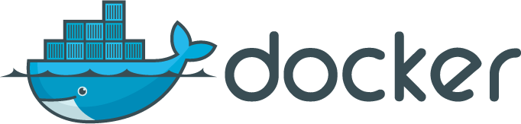

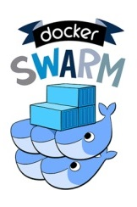
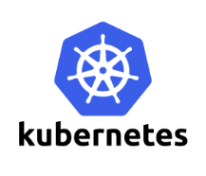

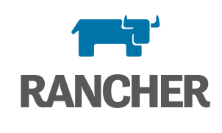
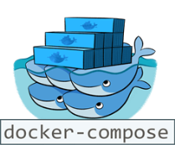
Container Technologies
Containers
Light-weight OS/application-layer virtualization
Isolation: From other Apps and OS
Portability: Binary, Data, Config, Logs
Container Orchestration
Deploy and manage complex services
Scalability and high-availability

Slide 57
Docker
Docker is an open-source platform that enables developers to automate the deployment of applications inside lightweight, portable containers
Docker is a set of platform as a service (PaaS) products that use OS-level virtualization to deliver software in packages called containers

Slide 58
Kubernetes
Kubernetes is an open-source container orchestration system for automating software deployment, scaling, and management
Google originally designed Kubernetes (announced in mid-2014)
The Cloud Native Computing Foundation now maintains the project

Slide 59
Kubernetes distributions
Various vendors offer Kubernetes-based platforms or infrastructure as a service (IaaS) that deploy Kubernetes
Alibaba Cloud ACK (Alibaba Cloud Container Service for Kubernetes)
Amazon EKS (Elastic Kubernetes Service)
DigitalOcean managed Kubernetes Service
Google GKE (Google Kubernetes Engine)
IBM Cloud Kubernetes Services
Microsoft AKS (Azure Kubernetes Services)
Mirantis K0s
Oracle Container Engine for Kubernetes
Red Hat Openshift
SUSE Rancher Kubernetes Engine (RKE)
VMware Tanzu

Slide 60
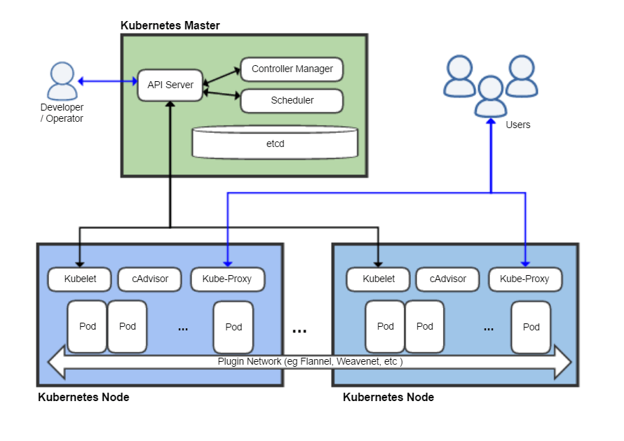
Kubernetes architecture

